Slide 1


Exploring Knowledge Learning from Raw Videos
Xun Guo
2024.12.16

Slide 2
Who am I?
Hi everyone, my name is Xun Guo (郭逊).
I am a third year master student at USTC, advised by Prof. Weiming Hu.
Research interests: AIGC, especially in scalable video generation and its applications.
Research experiences: Shanghai AI Lab, KLING AI, ByteDance Research (Intelligent Creation).

Slide 3
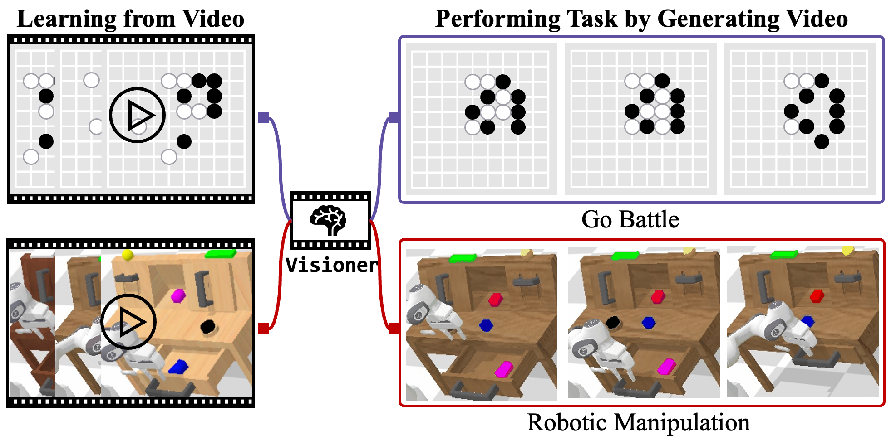
Learning from videos

Slide 4
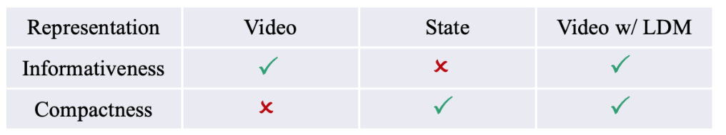
Problem
We focus on knowledge acquisition from visual data.
Challenges:
Previous methods focus on text-based models like large language models (LLMs), so how to design the overall framework?
How to represent visual data in a low dimension space?
How to realize long-term, complex reasoning?

Slide 5
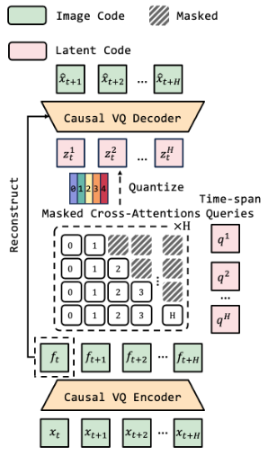
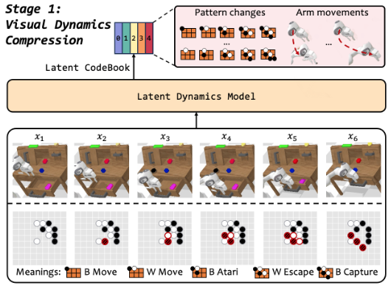
Method Overview
(a) Stage1: Visual Dynamics Compression

Slide 6
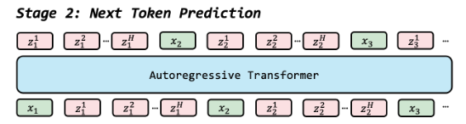
Method Overview
(b) Stage2: Next Token Prediction

Slide 7
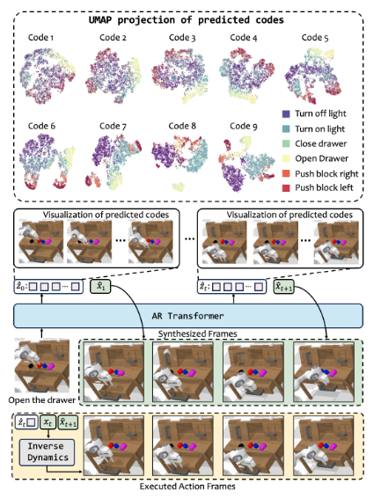
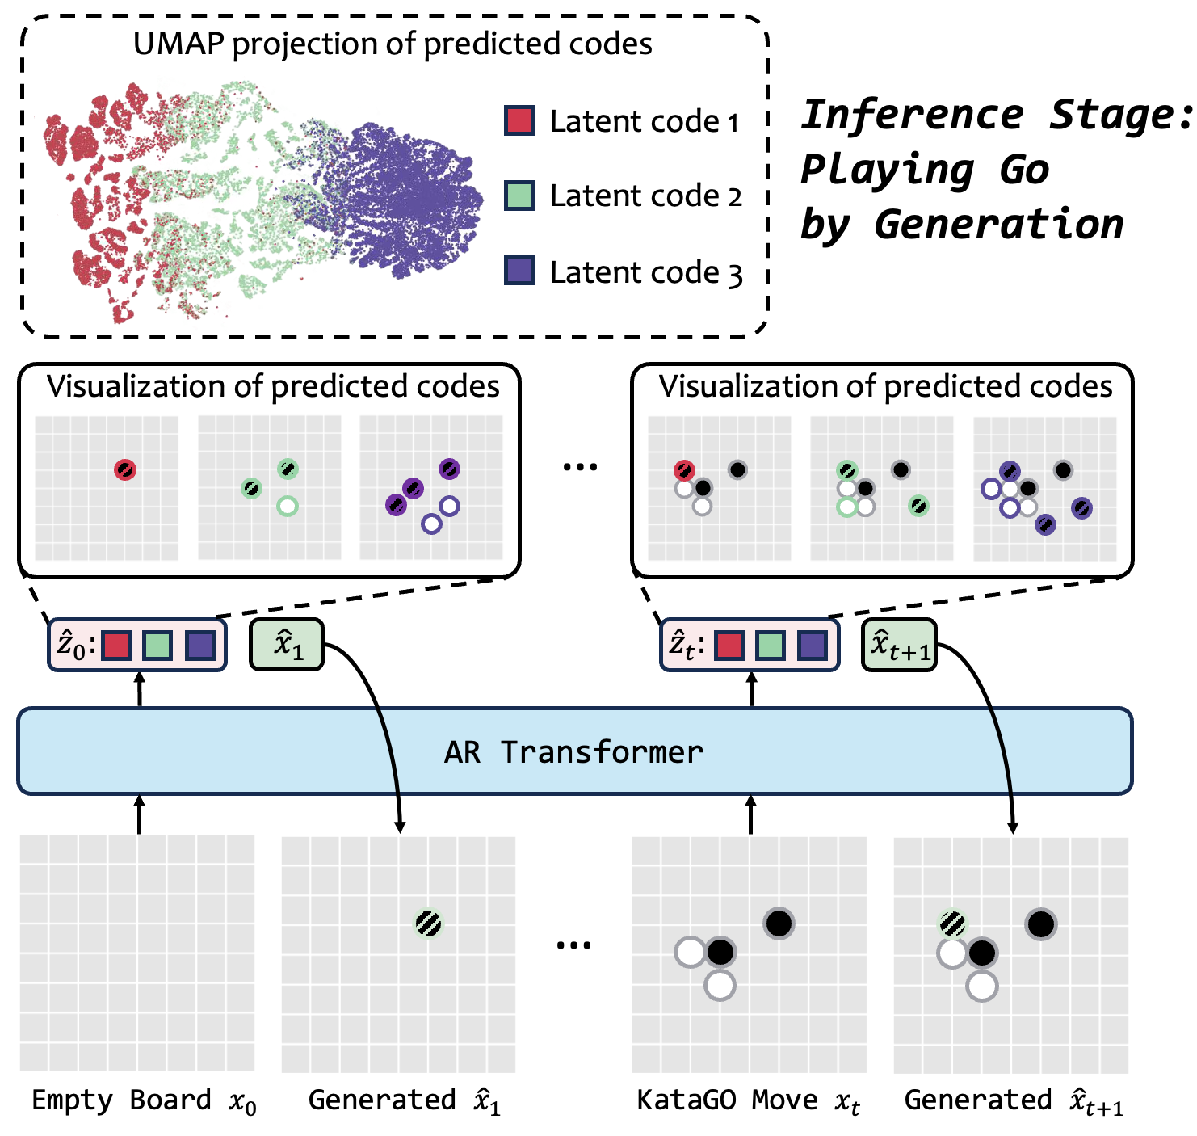
Method Overview
(c) Inference

Slide 8
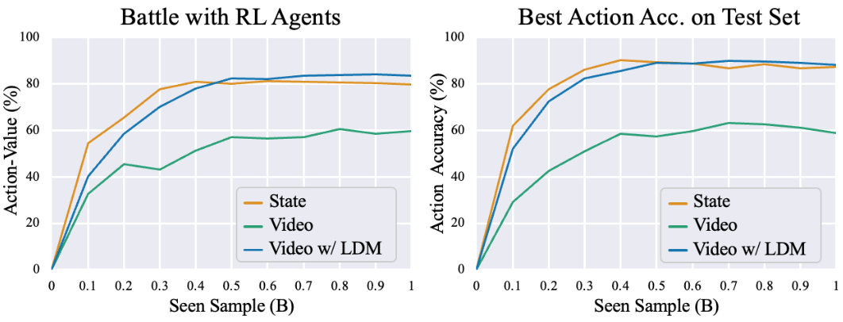
Experimental Results
Our method achieves 5-dan level in professional video-based Go.

Slide 9
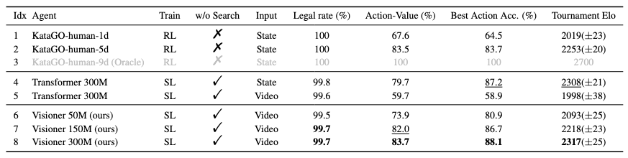
Experimental Results
Comparison on Video-GoBench, a self-collected 10 million 9x9 Go game benchmark.

Slide 10
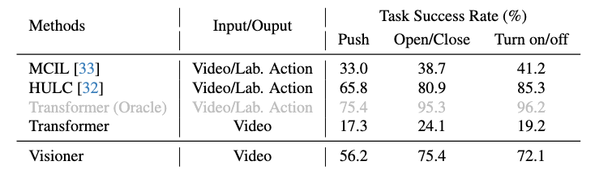
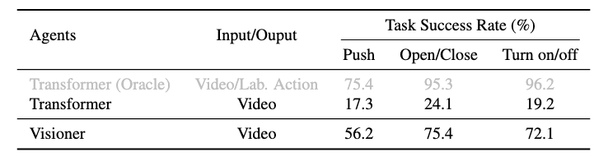
Experimental Results
Comparison on CALVIN, a Robotic Manipulation benchmark.

Slide 11
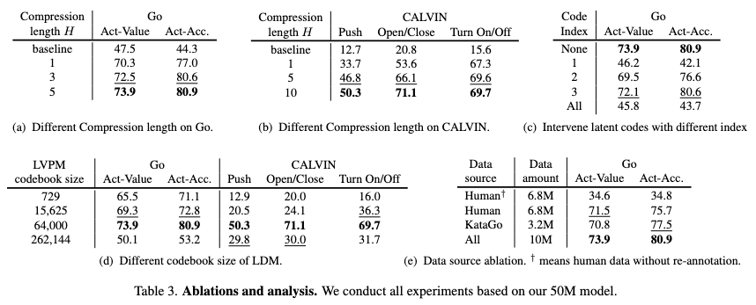
Experimental Results
Ablation studies.

Slide 12
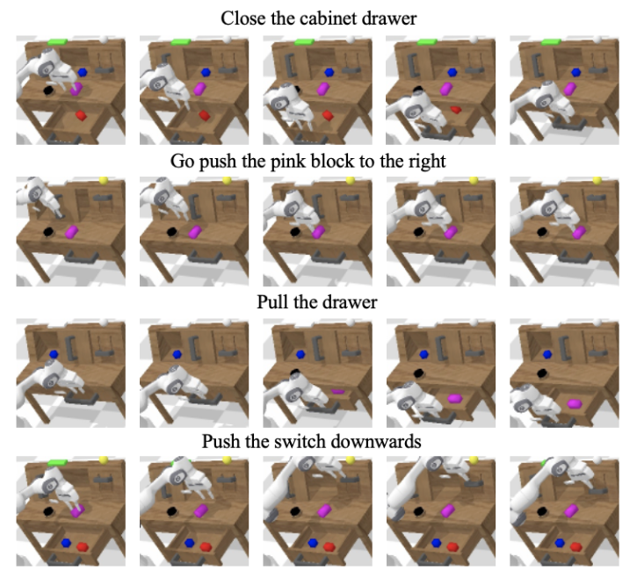
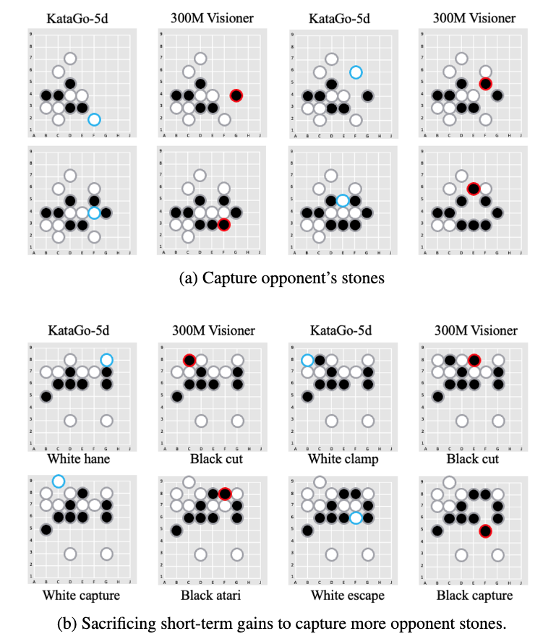
Experimental Results
Visualize Results.

Slide 13
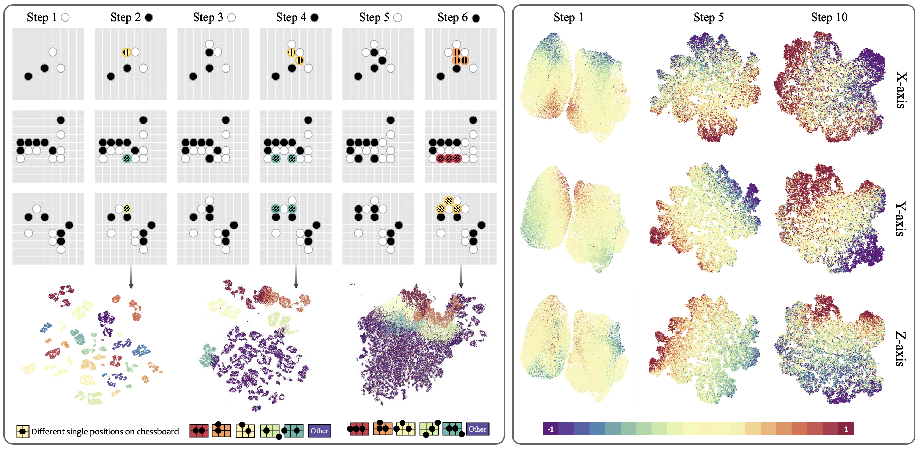
Experimental Results
Visualizations of learned embeddings.

Slide 14
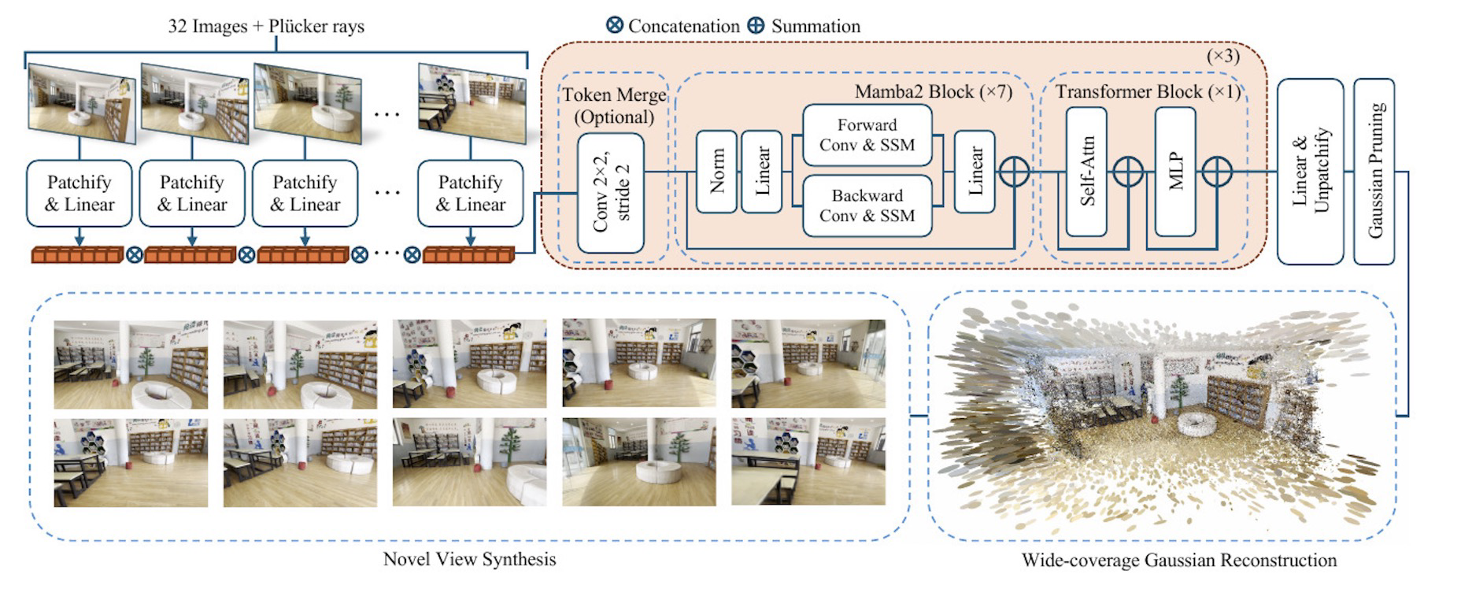
Gaussian Scene Generation
Motivation.
We aim to Generate Scenes with MV-GS Representations.

Slide 15
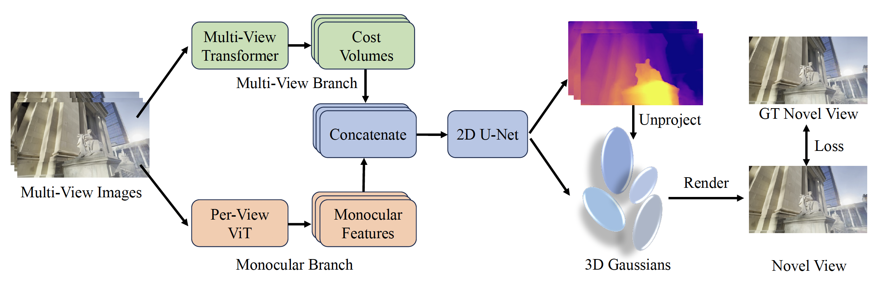
Gaussian Scene Generation
Overall Pipeline.
Step1: Obtaining MV-GS Representations.

Slide 16
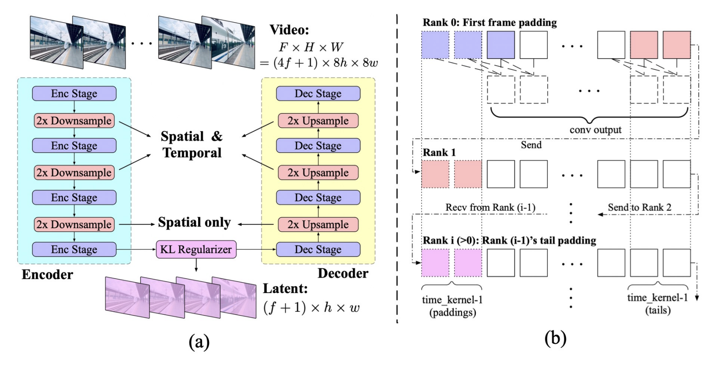
Gaussian Scene Generation
Overall Pipeline.
Step2: MV-GS Compressor → A Latent VAE.

Slide 17
Gaussian Scene Generation
Overall Pipeline.
Step3: MV-GS Generator → We train a diffusion model to generate MV-GS latents.
Work still in progress.

Slide 18
Thanks for watching :)

